Slide 1
Intro to R
R Ladies #LdnOnt
May 1, 2017
Rachael Smyth, MSc
MClSc/PhD Student
Notes:
Hi everyone. My name is Rachael Smyth and I’m in my second year of the concurrent MClSc/PhD program in Speech Pathology at Western. I’ve been using R since I was in my MSc program and have taken a number of courses using R and helped develop some online modules to teach test construction in R. Today’s presentation is made up of 2 parts. First I’ll do a bit of brief orientation to R and Rstudio and then we’ll delve into scripting in R and we’ll do a bit of hands on script creation together.

Slide 2
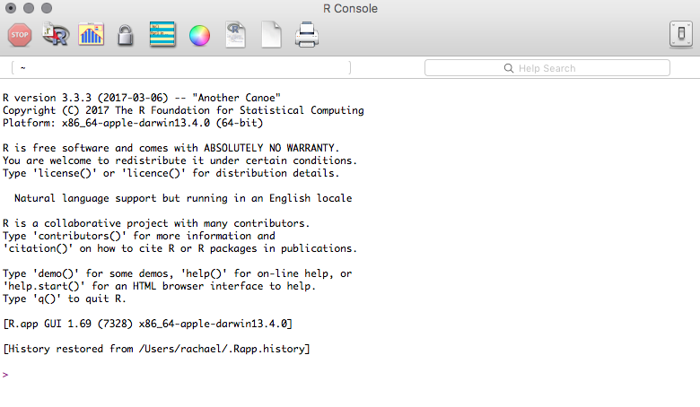
R
Notes:
R contains a console that allows you to type commands to perform analyses. You can also use it as a calculator by typing in the equation you want to solve

Slide 3
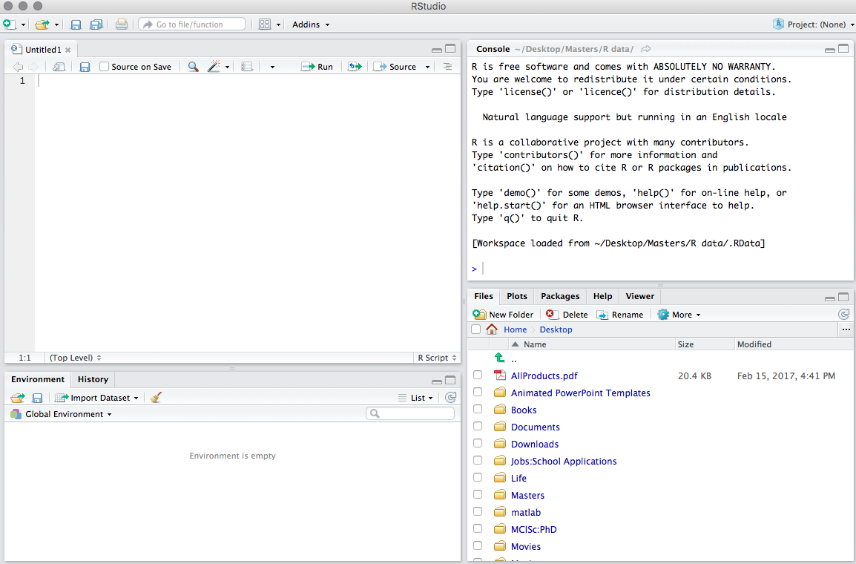
RStudio
Notes:
RStudio contains the same console, but also has sections to write scripts, Markdown files, text files etc. On the next slide you’ll be able to look at the options in terms of types of files that can be created in Rstudio. Rstudio also has an area that displays your file sources (you can set this to display a certain folder or file by default). This section of Rstudio is also where you can install packages and make sure the packages you need for you analyses are loaded, it is where your plots and graphs will display if they are part of you analysis, and also you can use it if you are unsure about an analysis to use by searching in the help section. It will bring up the R documentation on the topic you search. Another way to get help with things is to use the console and type ?? (with the name of the package you want information about after). Finally, Rstudio displays the environment for you. This is where you will see all the variables you create and datasets you bring in.

Slide 4
Analyses in R
R and the R console in RStudio can be used to run analyses just by typing in whatever analysis/commands you want run
You can also set variables in R and in the R console in Rstudio
Running analyses in this way can be helpful in certain circumstances
> 2 + 2
> 5 * 3
> X <- 3
> Y <- 4
> x * y
Notes:
So first I thought we could quickly look at how you can use the R console in R or in Rstudio to quickly run calculations. You can really run any calculations you want, but I came up with a few. It’s also good to note how in the last one, when you set x to 3 and y to 4, you can see the variables appear in the environment in Rstudio.
[flip to R and demonstrate the analyses in the console]

Slide 5
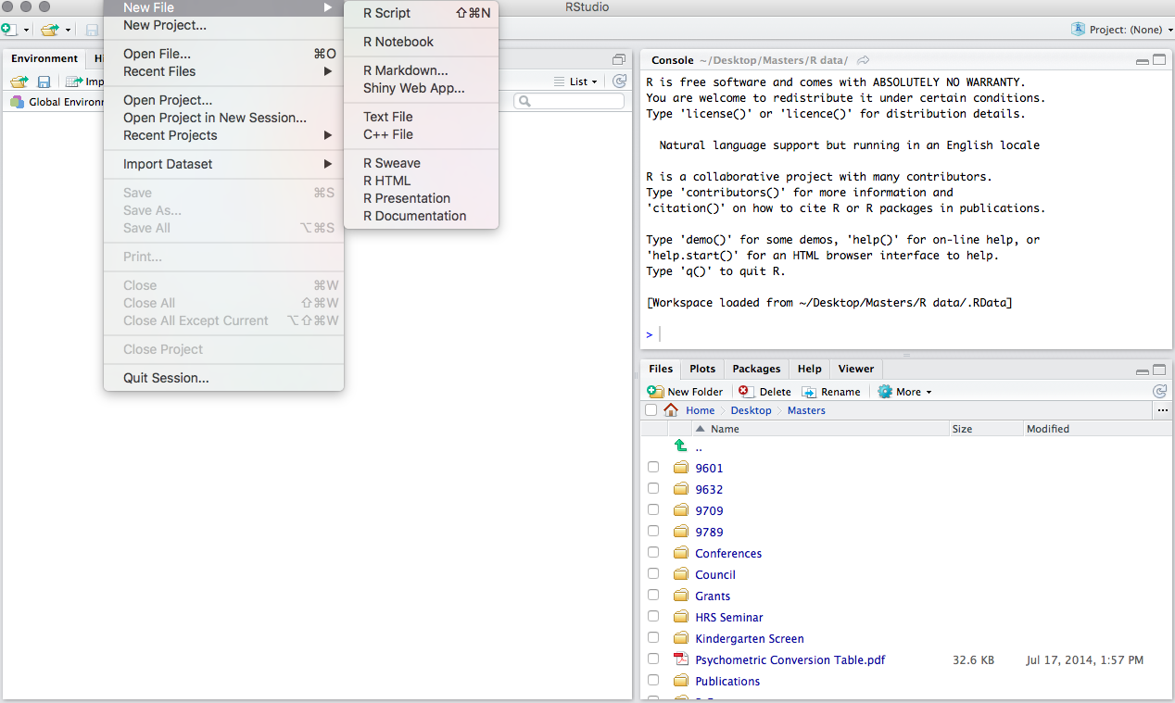
Scripts in R
Notes:
So, now we’ll move on to scripting. To start a new script in R, go to file, new file, r script. On a Mac you can also use “shift command N” to open a new script file.

Slide 6
Writing Scripts
A script is a .R file that contains the same types of commands as are run in R or in the R console in Rstudio
Scripts allow you to:
Compile all the analyses for one project into one file
Re-run analyses with relative ease
Add comments/annotations to the file
Notes:
Scripts are great! They are saved as .R files and basically they are made up of the same type of commands that you might use in the console, but they offer a few advantages that the console can’t. Scripts allow you to compile all your analyses for one project into one file which is very convenient. They also allow you to re-run your analyses with relative ease. And one other thing I really like about scripts is that you can add comments or annotations to the file to describe what you’re doing, or remind yourself of why you made a decision you made. I find this particularly handy if I haven’t worked on a certain project in a little while. As long as I’ve done a good job annotating my scripts, it’s easy for me to pick up where I left off.

Slide 7
A Brief Intro to R Conventions in Script Writing
# - Add a comment or notation without impacting the code
<- - Set a variable or function
$ - Select a variable from a dataset
(dataset $ variable)
~ - “as predicted by”
(variable ~ variable)
Notes:
There are a few symbols that I’ll use in my script writing explanation so I just wanted to review them before we start script writing
The # (pound symbol) is used to add comments or notations to your code
<- the arrow sets a variable or function
$ - selects a variable from a dataset

Slide 8
(Some) Considerations for Script Writing
What packages do you need to run?
What analyses are you going to run?
Do you need to create any functions?
How will you name your variables and functions?
How do you want to see your output?
What works best for you?

